Slide 1
Seminar An Introduction to Deep Generative Models: Techniques and Applications July 29, 2024 Alexandre Cortiella (ALIS)

Slide 2
Outline
Outline of the seminar
Motivation
Introduction to Generative AI
Key challenges in Generative AI
Deep Generative Models
Autoregressive models (AR)
Variational AutoEncoders (VAE)
Denoising Diffusion Probabilistic Models (DDPM)
Practical implementation in Pytorch
Energy applications

Slide 3
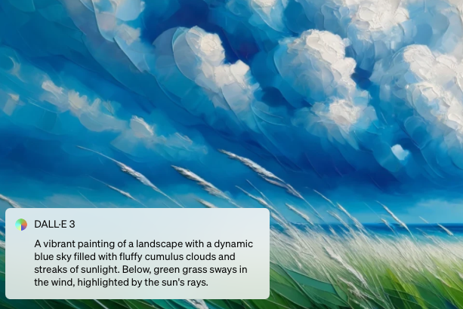
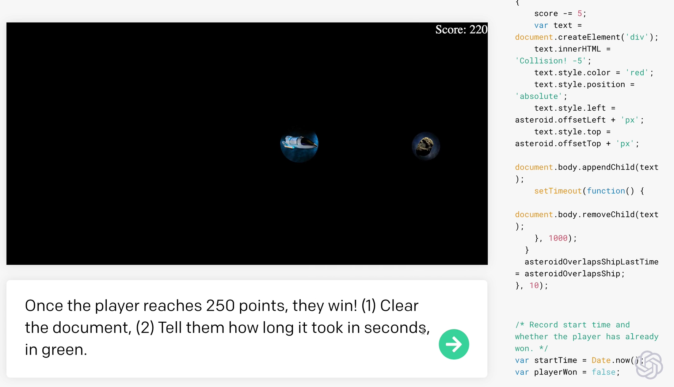
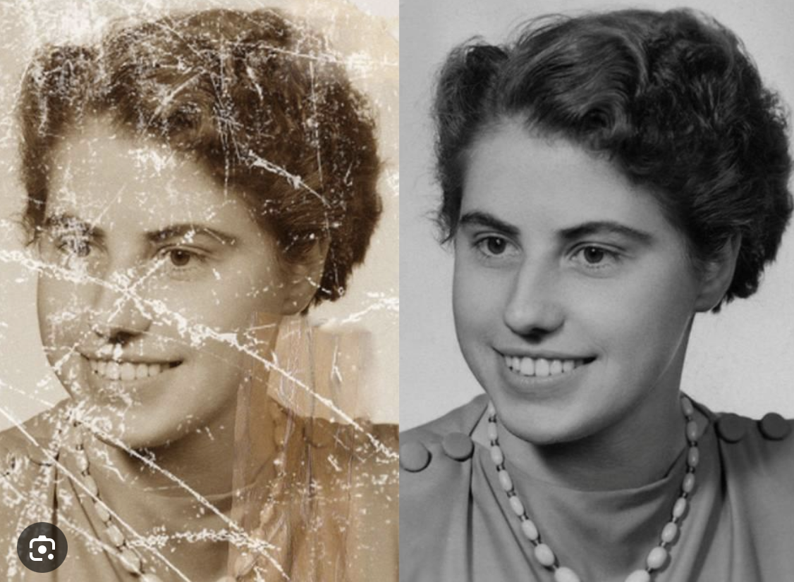
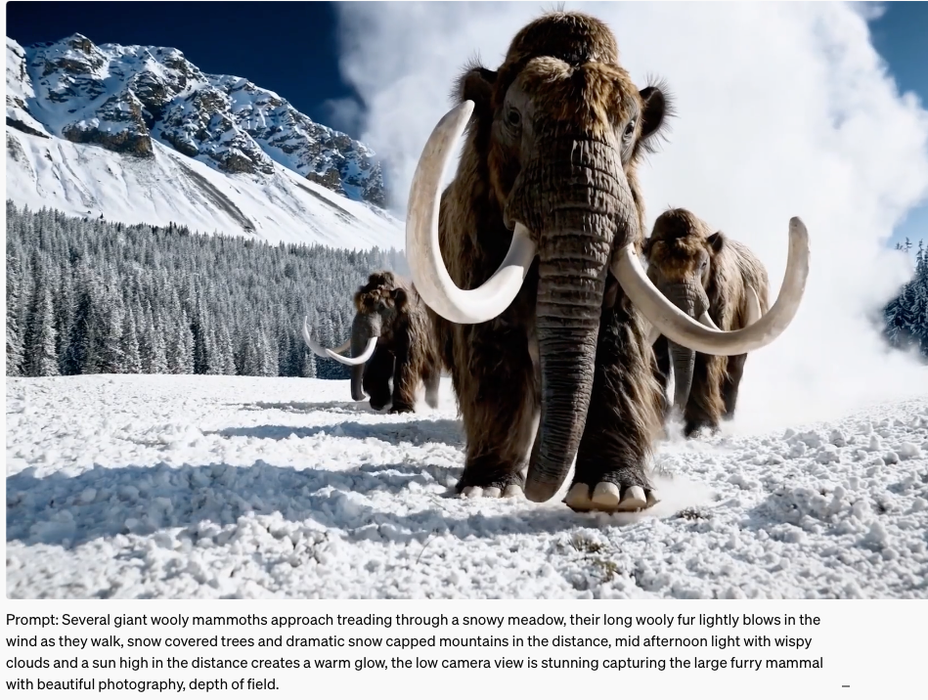
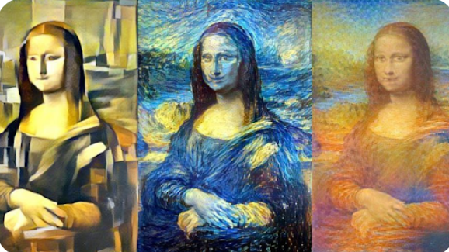
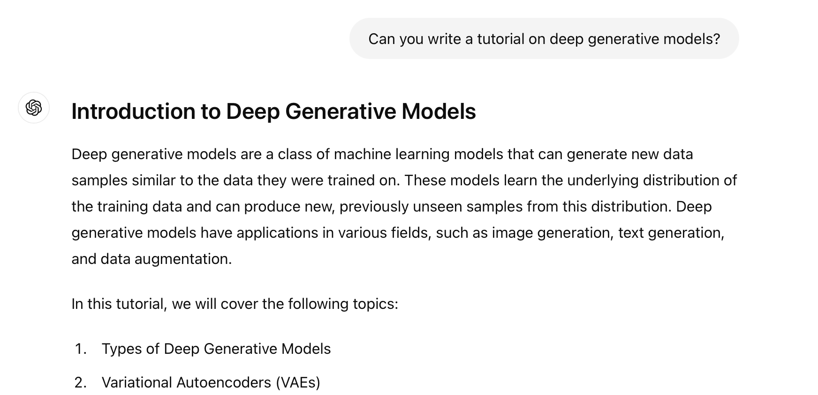
Motivation

Slide 4
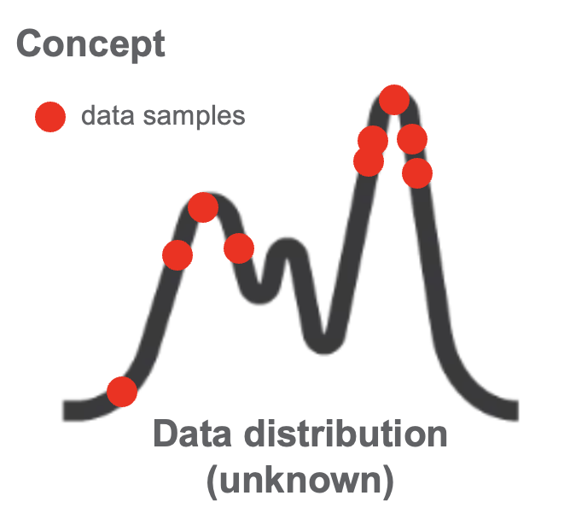
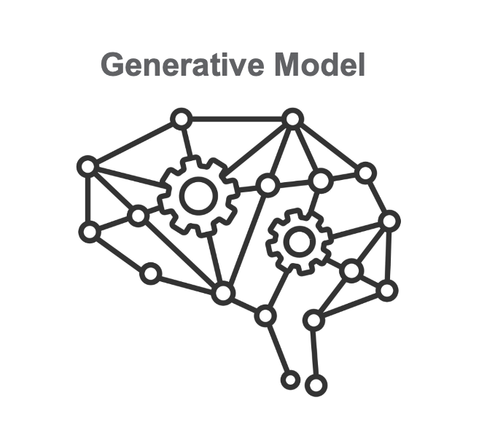
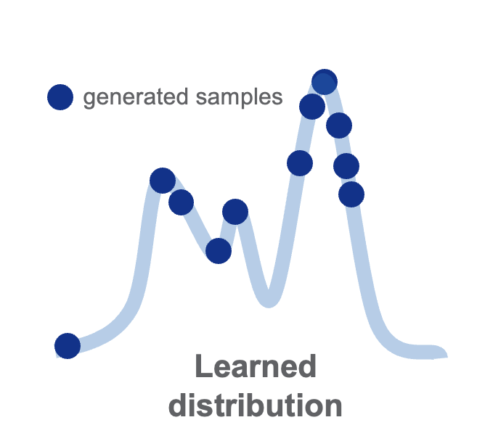
Motivation
What is Generative AI?
Generative AI models are ML models that learn the patterns and structure of data to generate new synthetic data with similar characteristics (potentially in a controlled way)

Slide 5
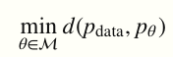
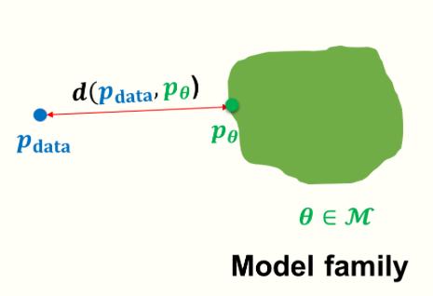
Key challenges
Learning - key questions:
What is the representation for the model family M?
What is the objective function d(⋅)?
What is the optimization procedure for minimizing d(⋅)?
Concept:
Inference - key questions:
Density estimation: Given a datapoint x, what is the probability assigned by the model, i.e., p_{θ}(x)?
Sampling: How can we generate novel data from the model distribution, i.e., x_{new}∼p_{θ}(x)?
Unsupervised representation learning: How can we learn meaningful feature representations for a datapoint x?
Source: CS236 Course lecture notes (Stanford)
https://deepgenerativemodels.github.io

Slide 6
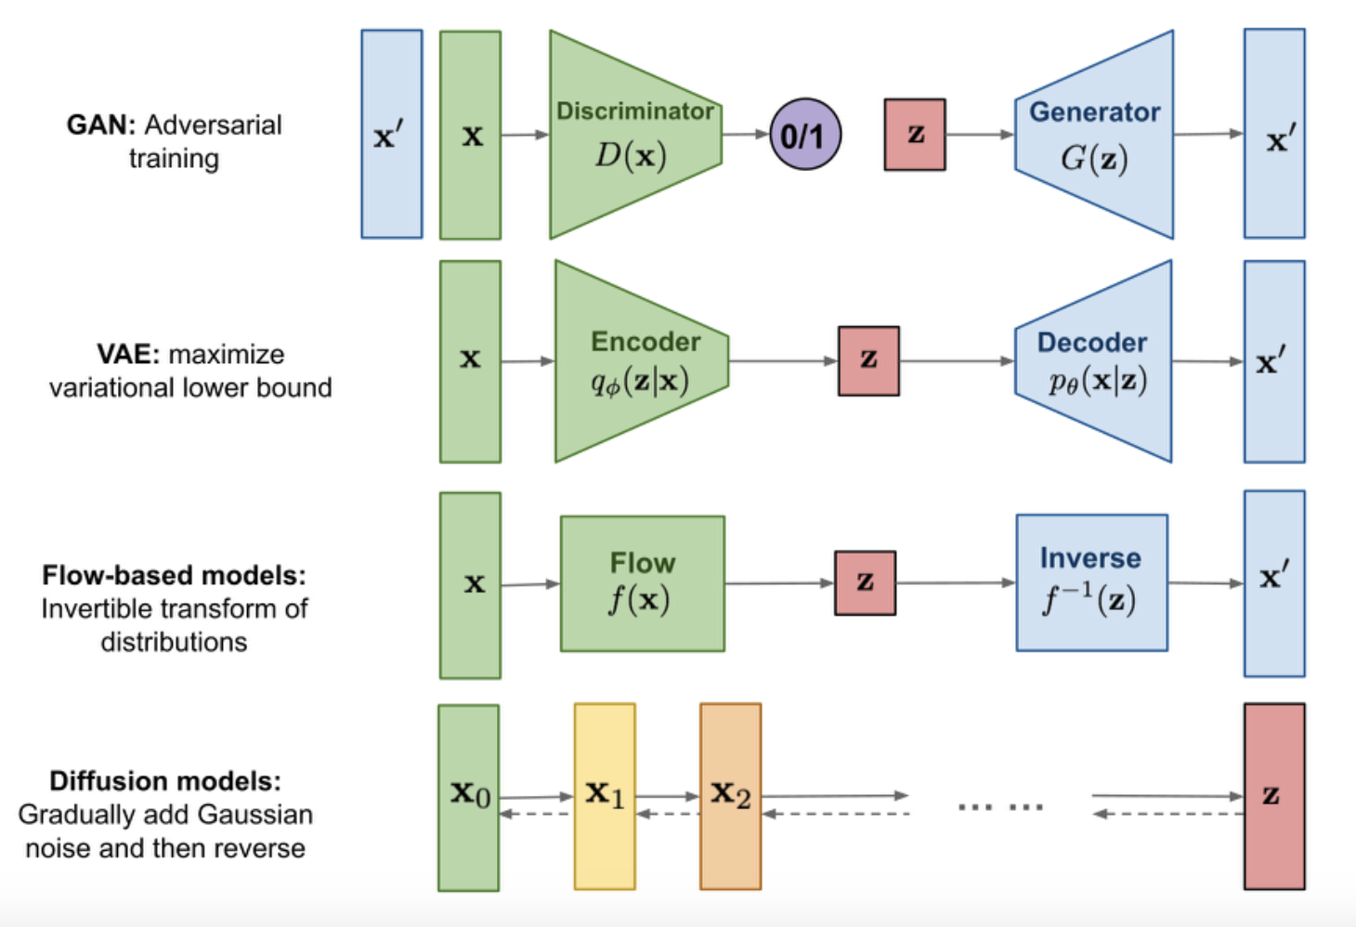
Deep Generative Models
Types of Deep Generative Models:
Source: Lil’Long’s blogpost
https://lilianweng.github.io/posts/2021-07-11-diffusion-models/
Autoregressive Models (AR)
Variational Autoencoders (VAE)
Generative Adversarial Networks (GAN)
Normalizing Flows (NF)
Energy-based Models (EBM)
Score-based Models (SBM)
Diffusion Models (DDPM)

Slide 7
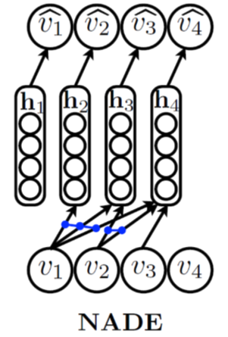
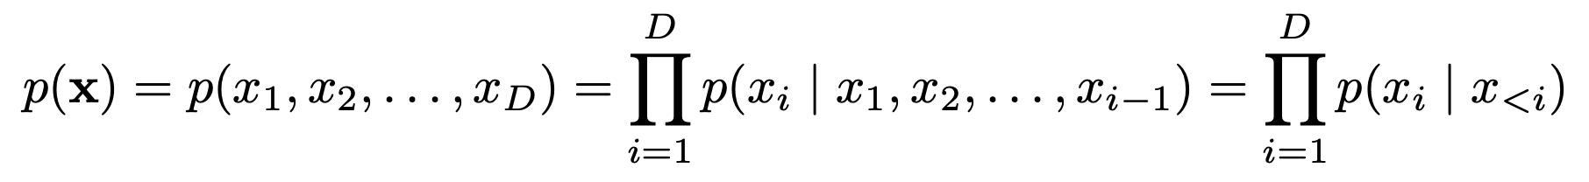
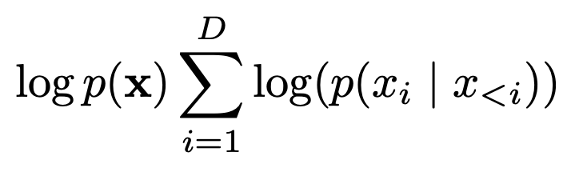
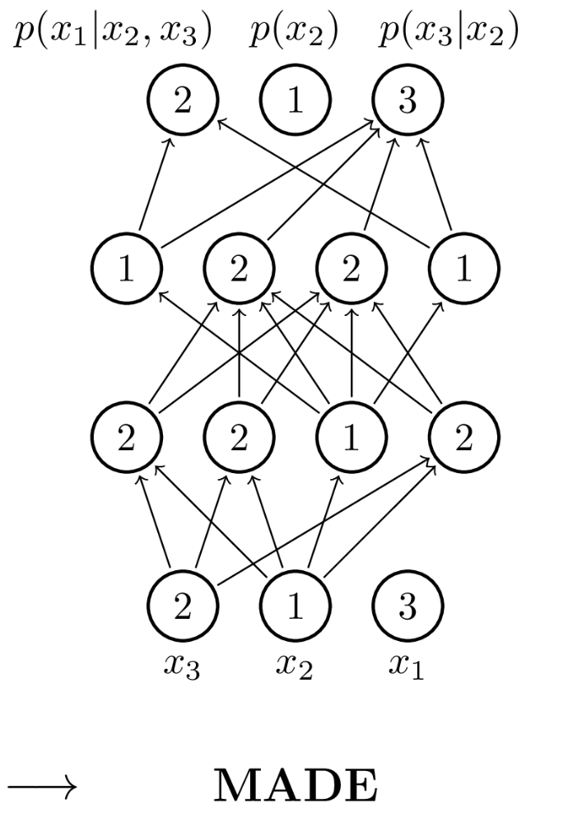
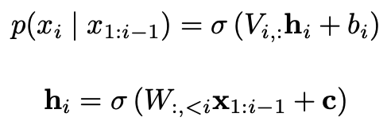
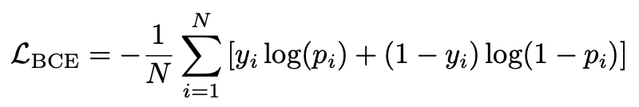
Deep Generative Models: AR
Autoregressive Generative Models (AR)
Log-likelihood:
NN parameterization (NADE):
Loss (binary case):

Slide 8
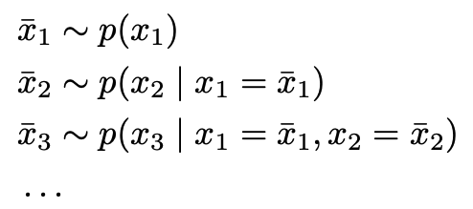
Deep Generative Models: AR
Autoregressive Generative Models (AR)
Training:
Sampling:
Likelihood evaluation:

Slide 9
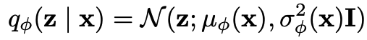
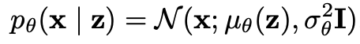
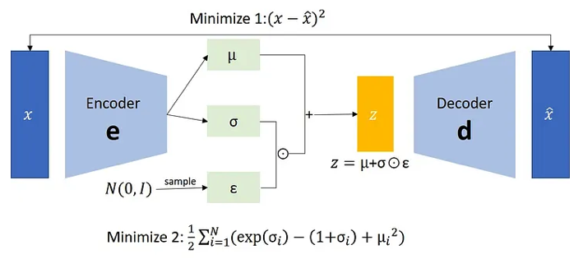
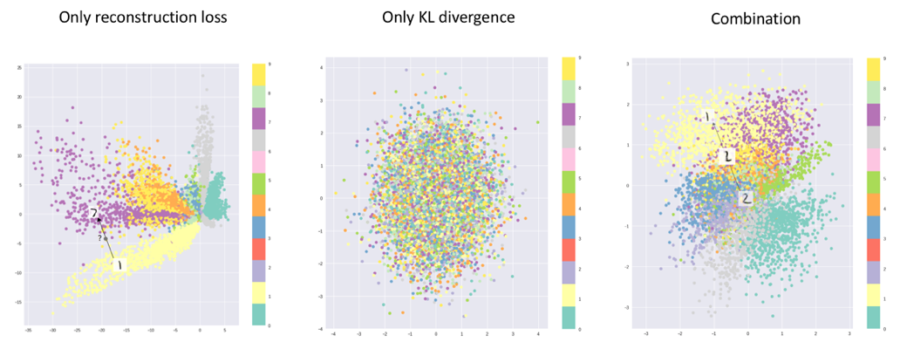
Deep Generative Models: VAE
Variational Autoencoders (VAE)
ELBO:
Encoder: (approximates posterior distribution)
Decoder: (likelihood of the data given the latent variables)
Source: https://www.linkedin.com/pulse/variational-autoencoders-vaes-ayoub-kirouane/

Slide 10
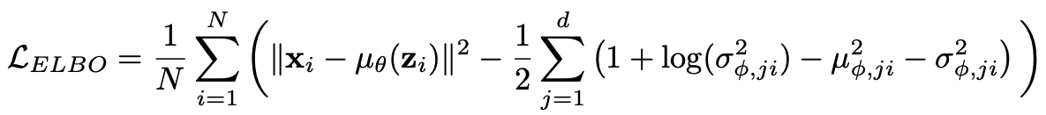
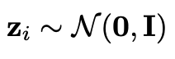
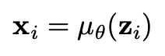
Deep Generative Models: VAE
Variational Autoencoders (VAE)
Training:
Sampling:
Sample latent variable:
Decode into input space:
Likelihood evaluation: only lower bound available

Slide 11
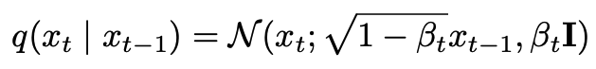
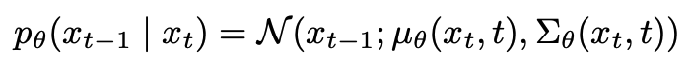
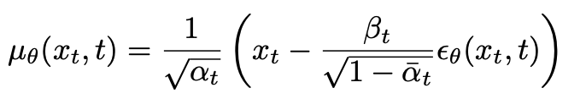
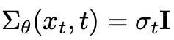
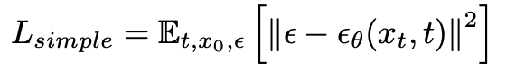
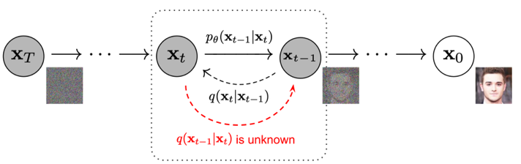
Deep Generative Models: DDPM
Diffusion Models (DDPM)
Forward process:
Reverse process:
Loss:
Source: Ho, Jonathan, Ajay Jain, and Pieter Abbeel. "Denoising diffusion probabilistic models." Advances in neural information processing systems 33 (2020): 6840-6851.

Slide 12
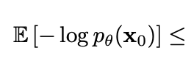
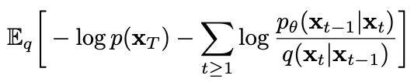
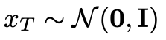
Deep Generative Models: DDPM
Diffusion Models (DDPM)
Training:
Sampling:
Sample from pure noise:
Use learned reverse process to denoise:
Likelihood evaluation: only lower bound available

Slide 13
Deep Generative Models: Implementation
Vanilla implementation in Pytorch
Dataloaders (training, validation and test sets)
Model (parametric probabilistic model)
Trainer (optimization procedure)
Sampler (sampling strategy)
Please visit:
https://github.com/alexandrecortiella/DeepGenerativeModels_Tutorial

Slide 14
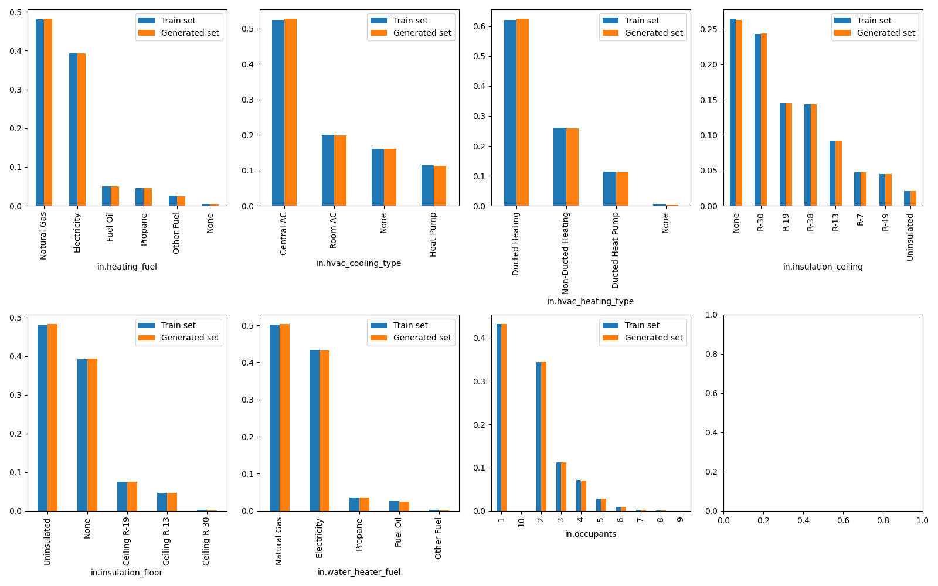
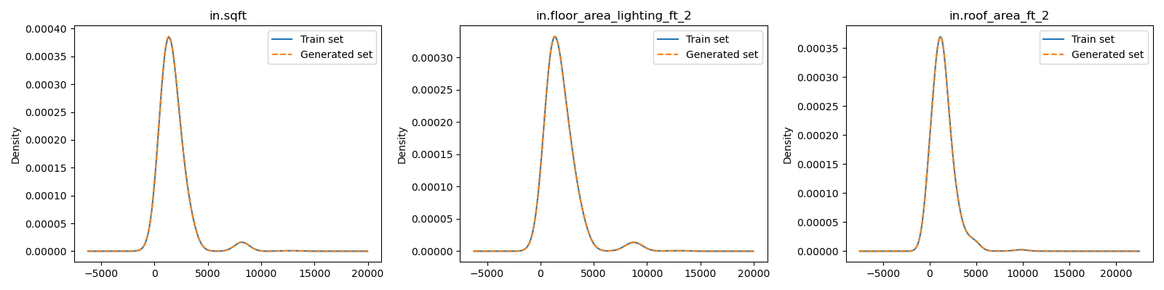
Deep Generative Models: Energy applications
Generative AI for community buildings
Results using TabDDPM algorithm
Diffusion model for continuous and discrete/categorical data
Dataset (Resstock data)
Training set: 351,872 samples
Generated set: 500,000 samples
# Continuous variables: 3
# Discrete variables: 7
Next steps: scaling TabDDPM to O(100) variables, implementation of conditional sampling (imputation)

Slide 15
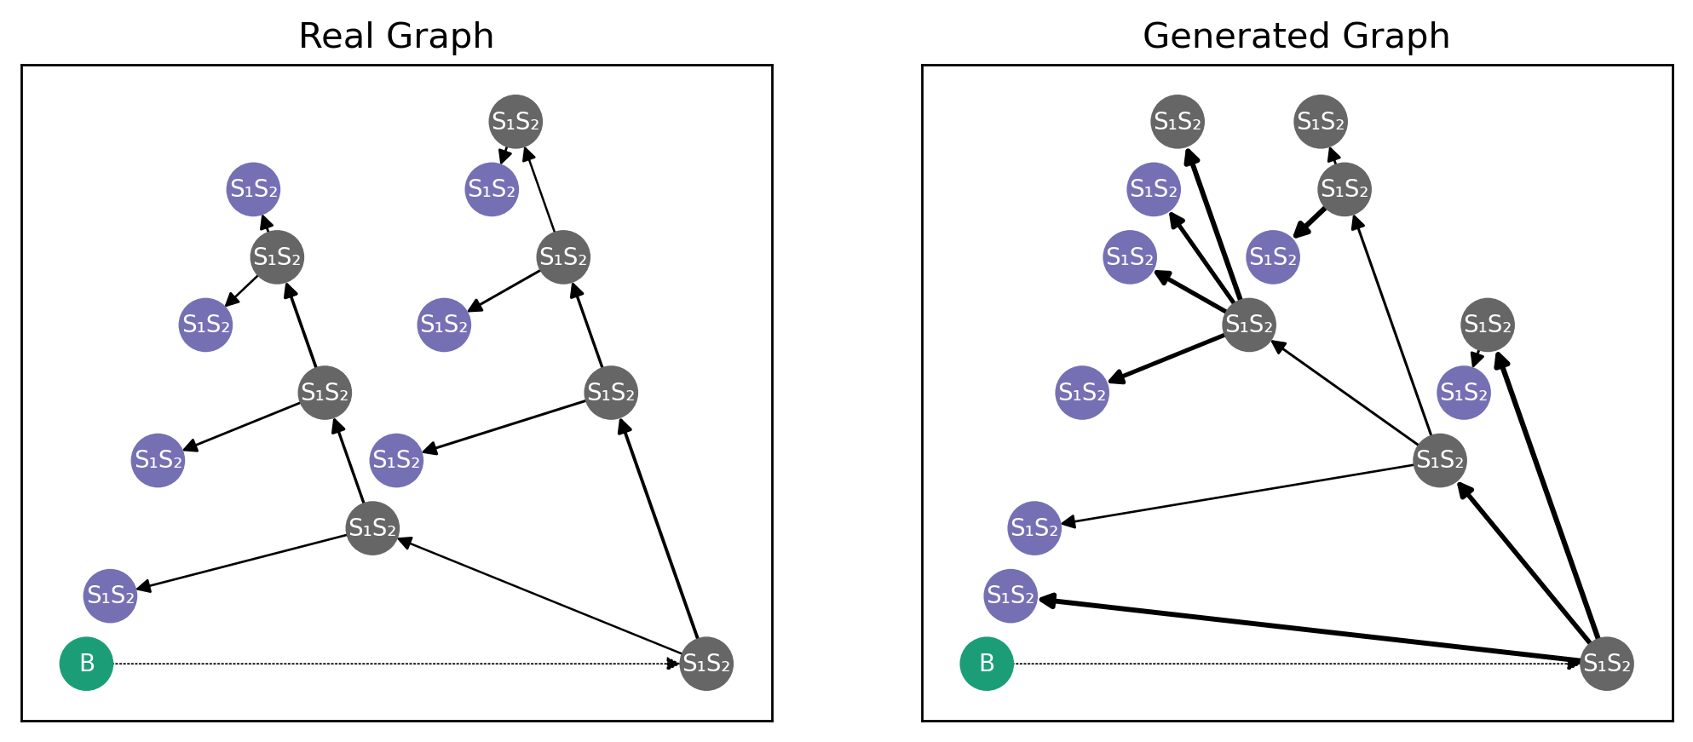
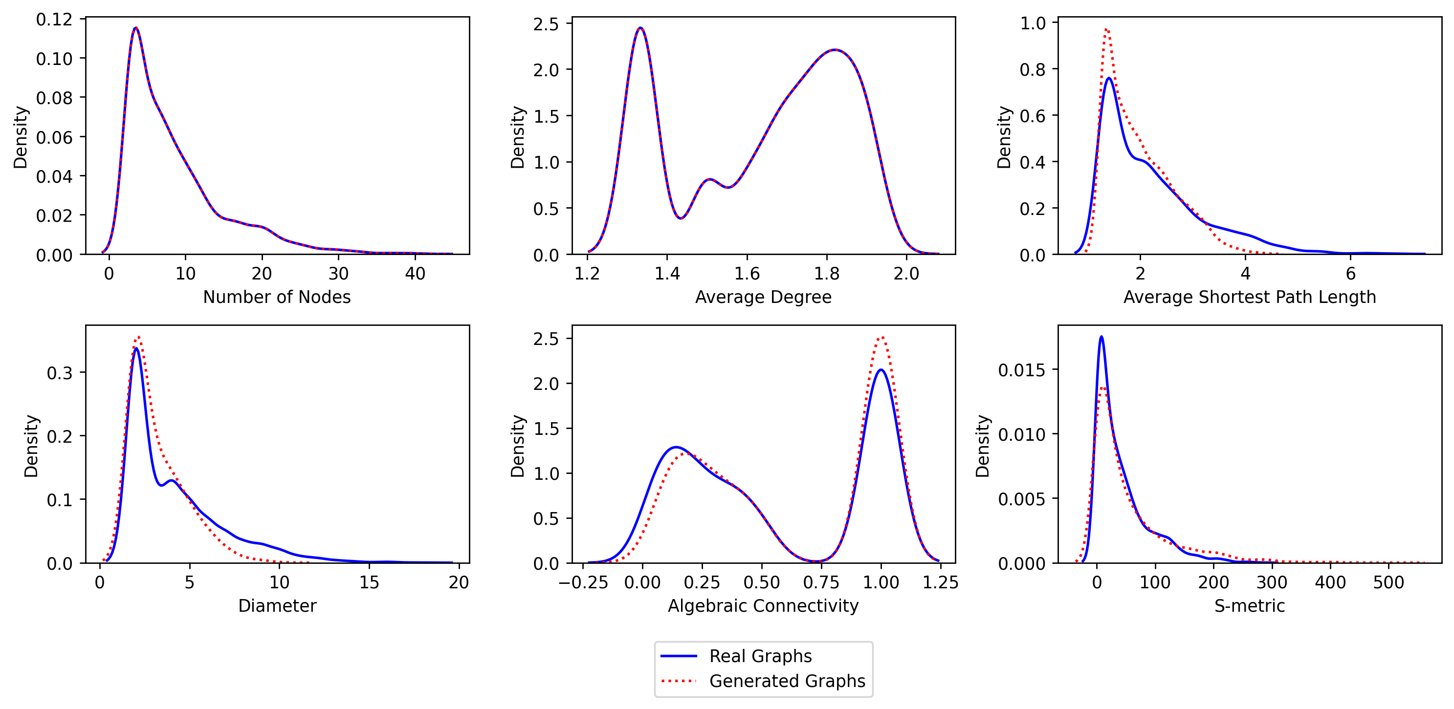
Deep Generative Models: Energy applications
Generative AI for power grid design
Challenges:
Addition of continuous and categorical node and edge feature distributions
Enforcement of grid topological constraints, no cycles in the distribution network
Inclusion of physical and compatibility constraints (phase, voltages, lengths…)
Scale training to larger graphs
Credit: Andrew Glaws (ALIS)

Slide 16
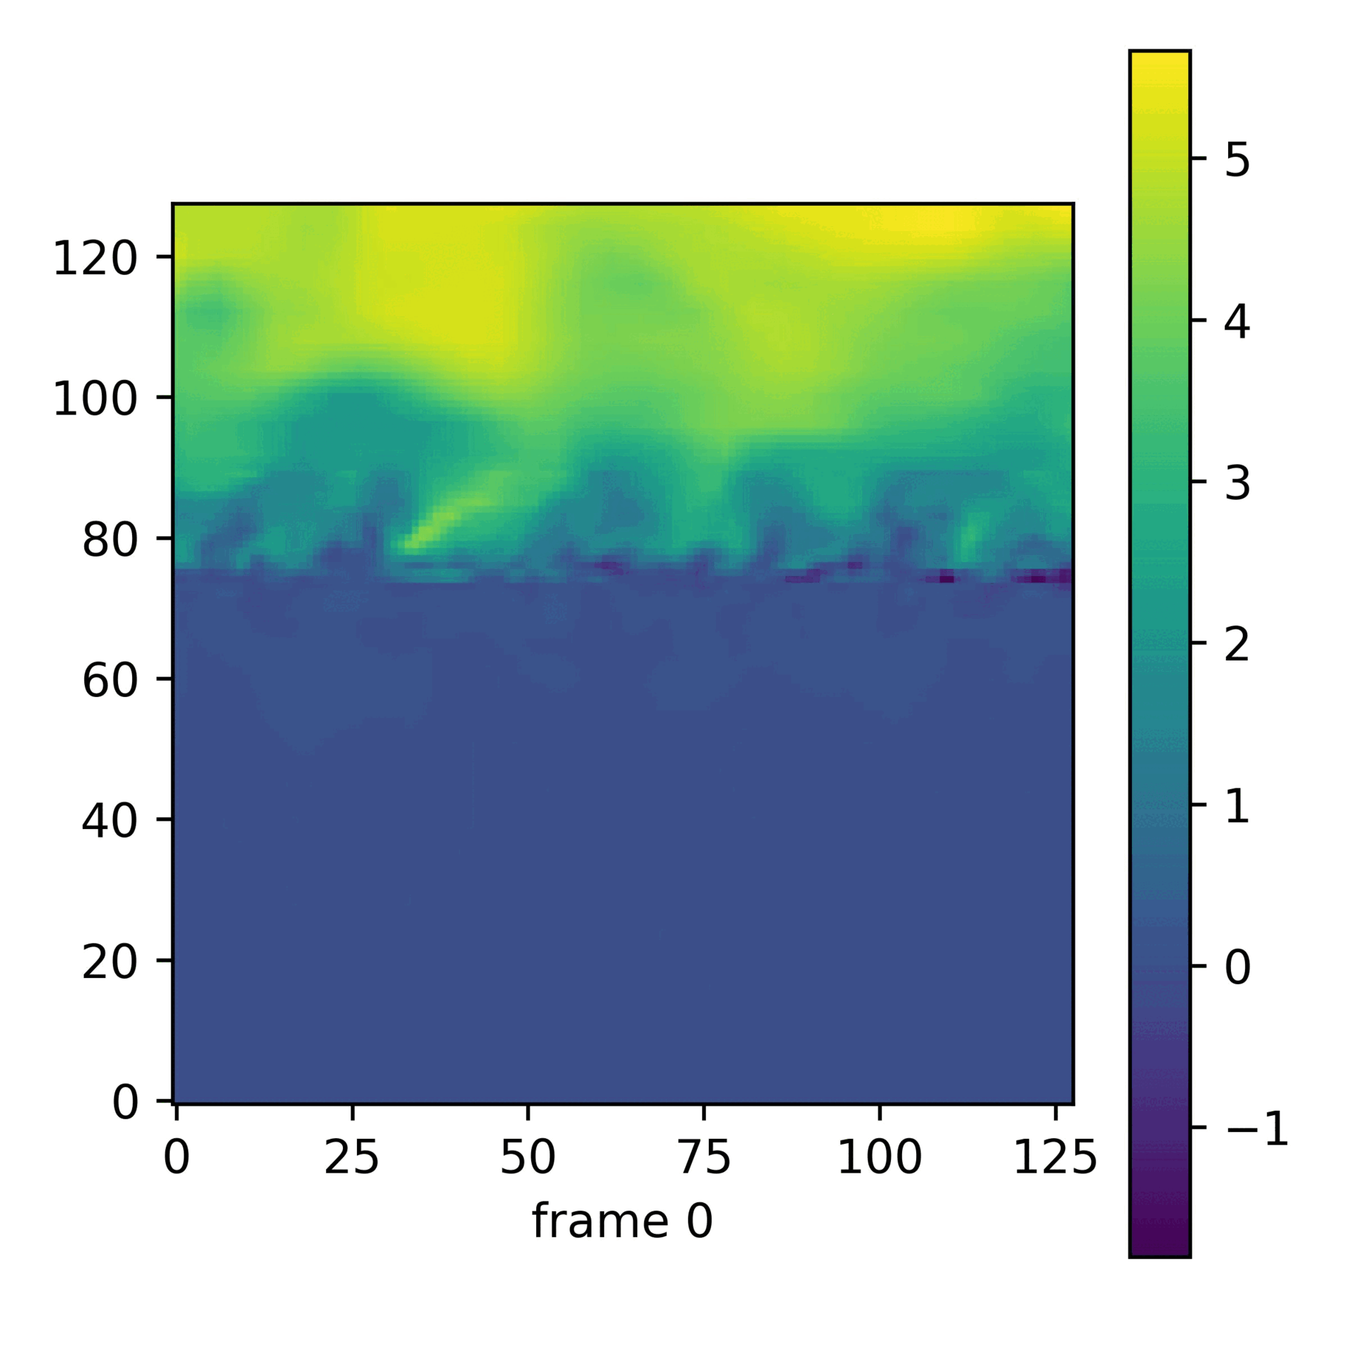
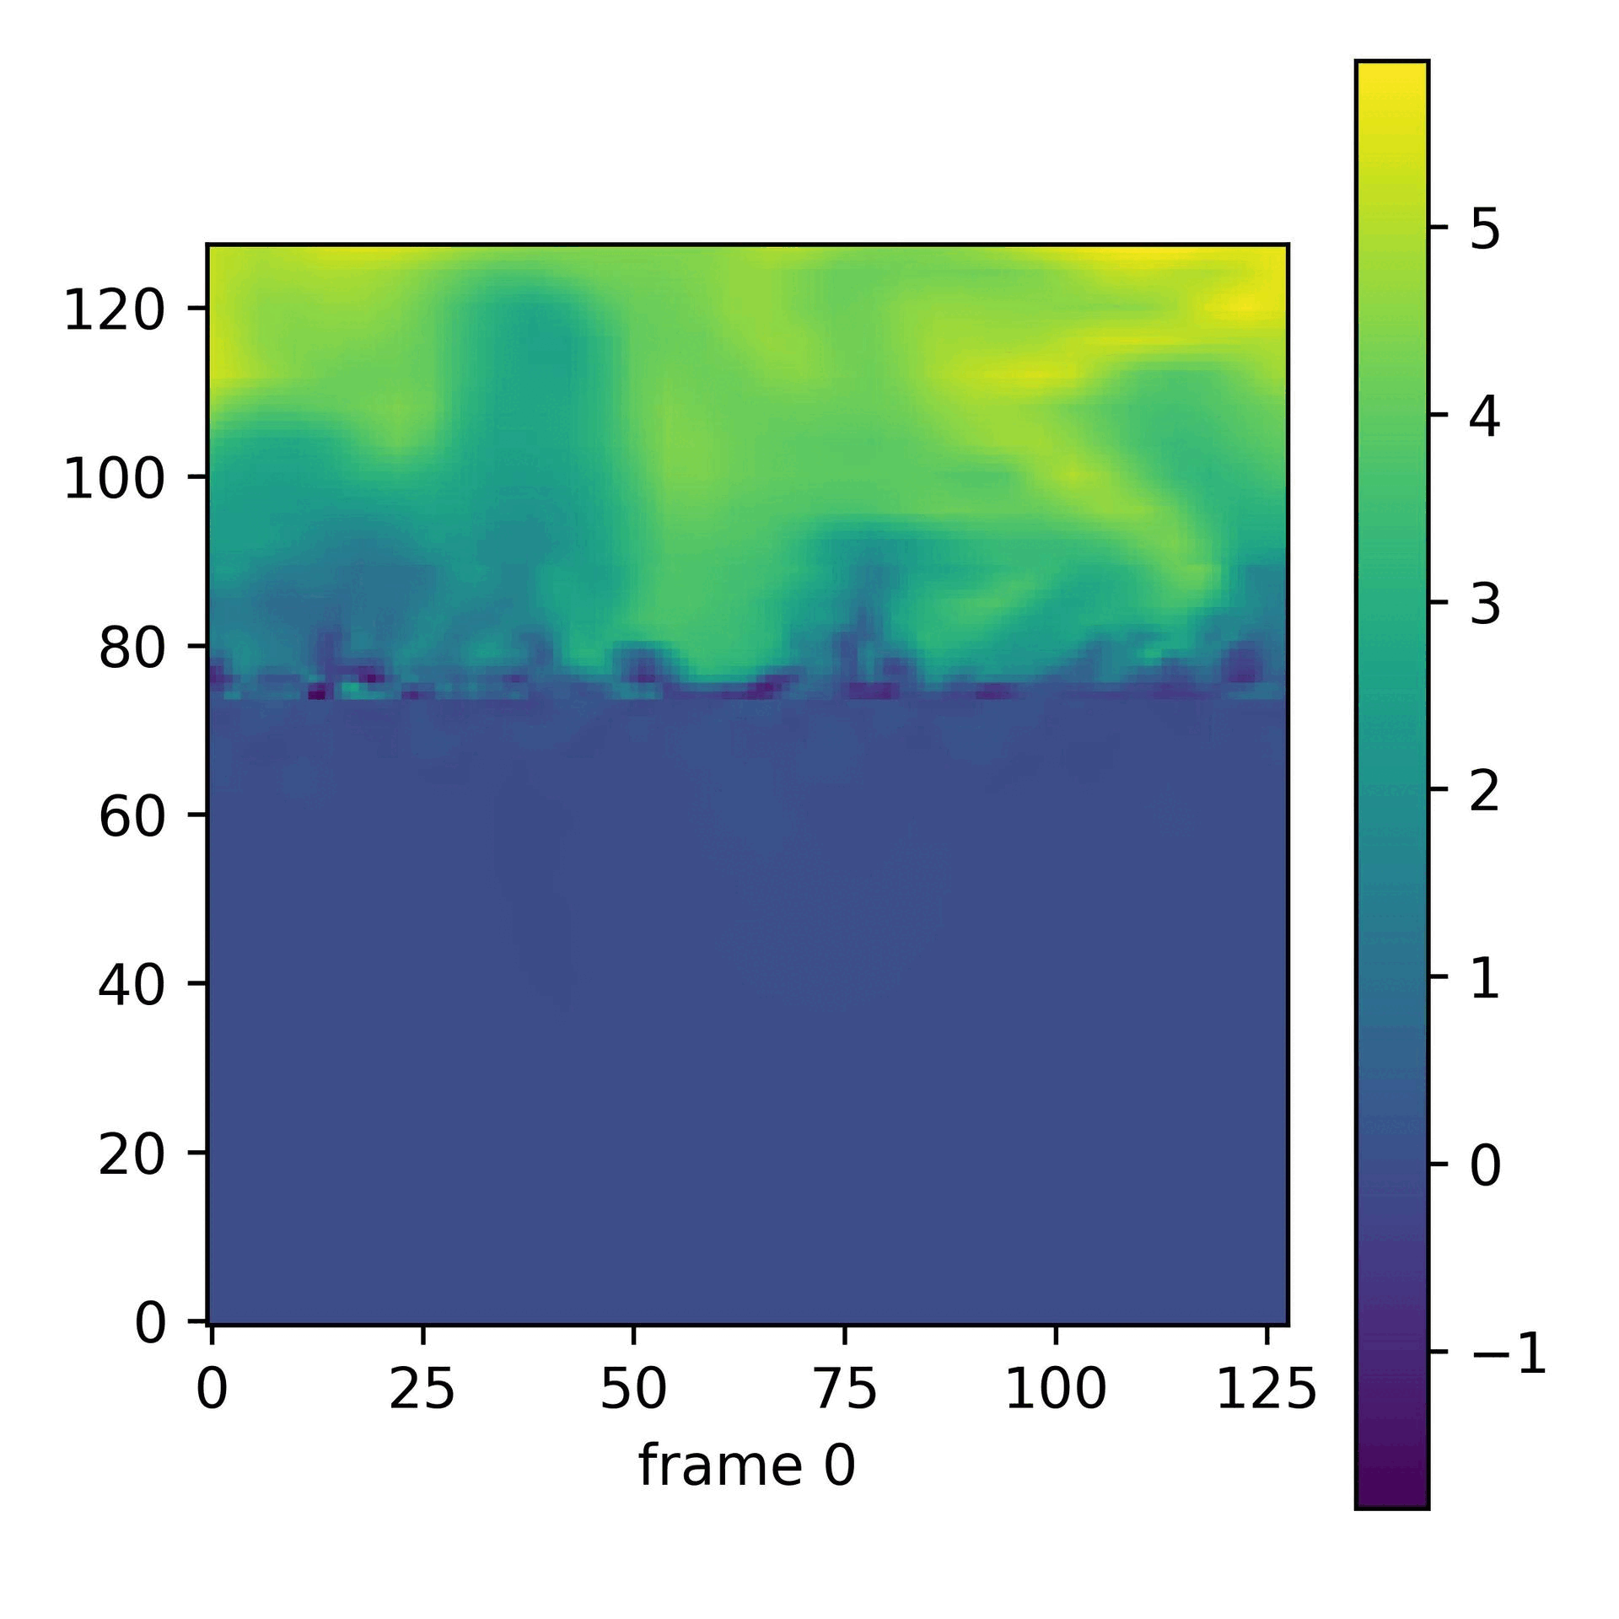
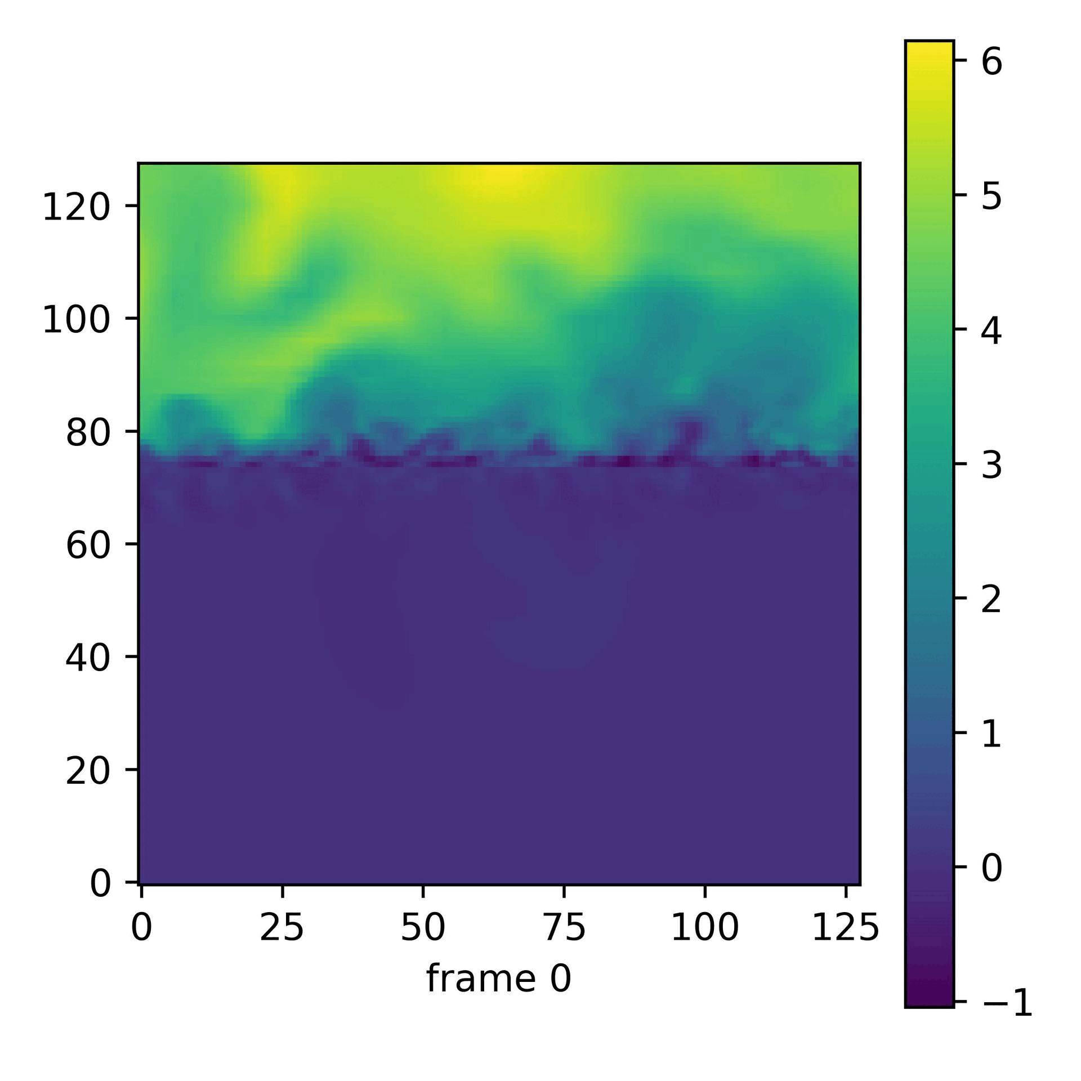
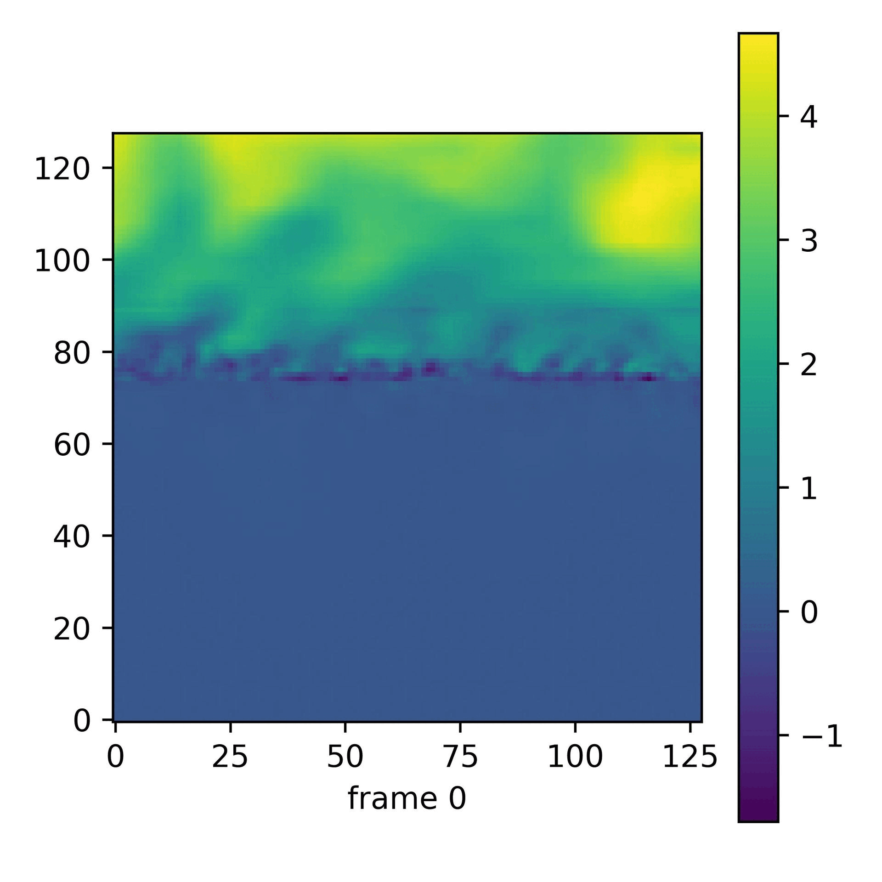
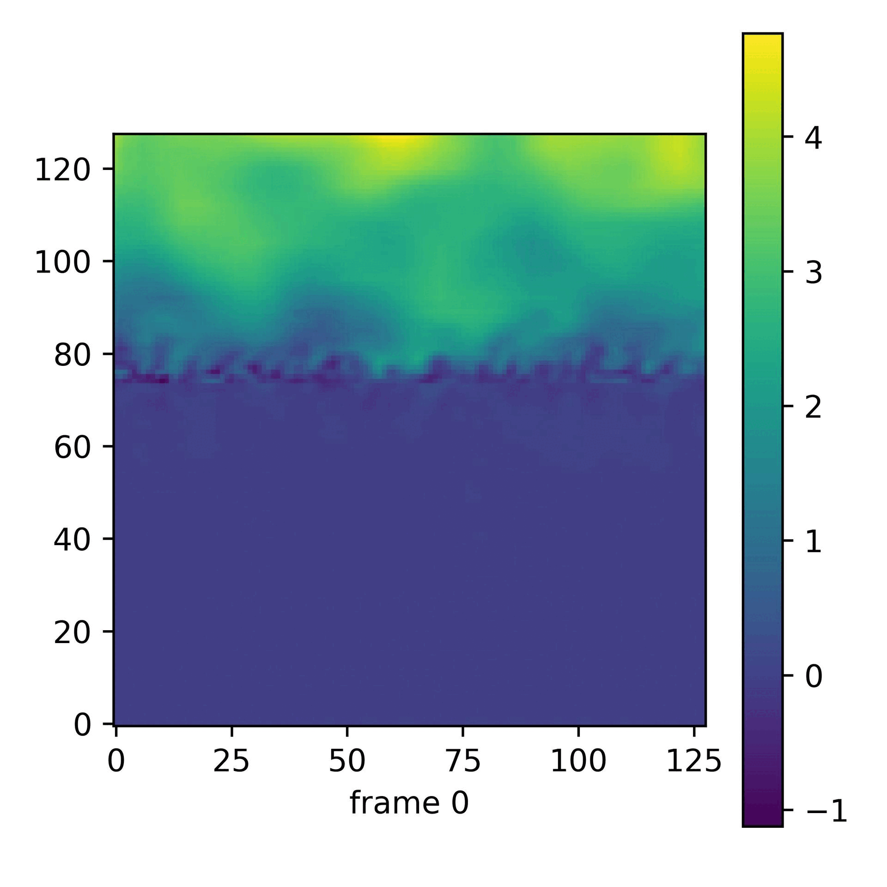
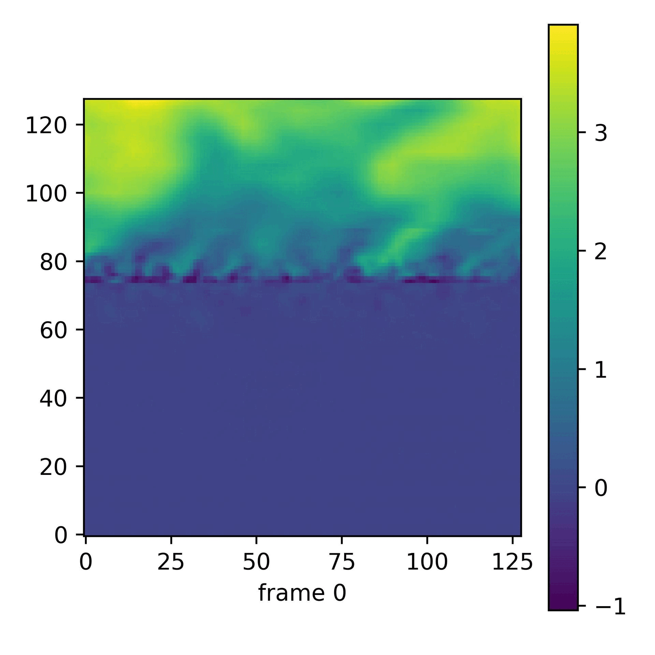
Deep Generative Models: Energy applications
Generative AI for wind-wave inflow generation
Test set
Resolution:
8 tiles of 128 x 128 per 1024 x 128 sample
16 frames per sample
Model:
DiT-video without latent encoding
Dataset:
# training samples: ~200
# validation samples: ~10
# test samples: ~10
Generated set

Slide 17
Acknowledgement
THANK YOU!
Alexandre Cortiella
ESIF A318-03B office (ALIS)
Alexandre.Cortiella@nrel.gov

